Slide 1
Market Basket Analysis, Customer Segmentation & Customer Lifetime Value
Data Mining Final Project
Akshat Arvind (aarvind@iu.edu)
Aniket Kale (ankale@iu.edu)

Slide 2
Dataset
Instacart Market Basket Analysis dataset hosted on Kaggle.
Link - https://www.kaggle.com/c/instacart-market-basket-analysis
Files in Dataset -
Products - [product_id, product_name, aisle_id, department_id]
Orders - [order_id user_id,eval_set,order_number,order_dow,order_hour_of_day days_since_prior_order]
Order_products__prior - [order_id, product_id, add_to_cart_order, reordered]
aisles - [aisle_id, aisle_name]
Department - [department_id, department_name]

Slide 3
Project Objectives
Drawing actionable insights using EDA.
Market basket Analysis using Association Rule Mining.
Customer Segmentation using RFM Analysis.
Computing Customer Lifetime Value (CLV) after customer segmentation using custom metric.

Slide 4
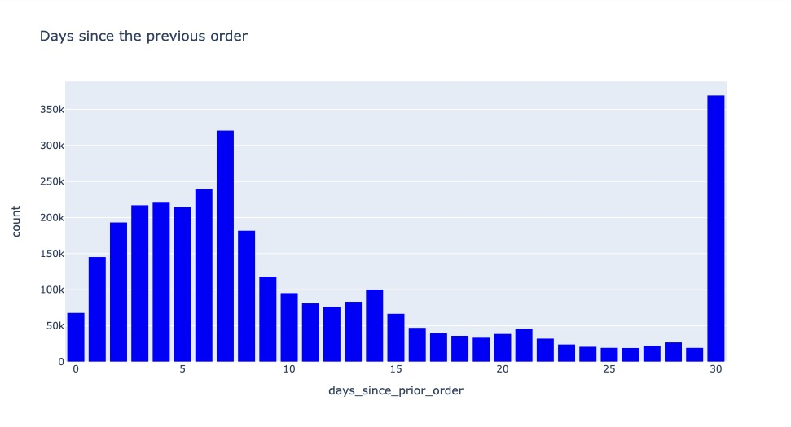
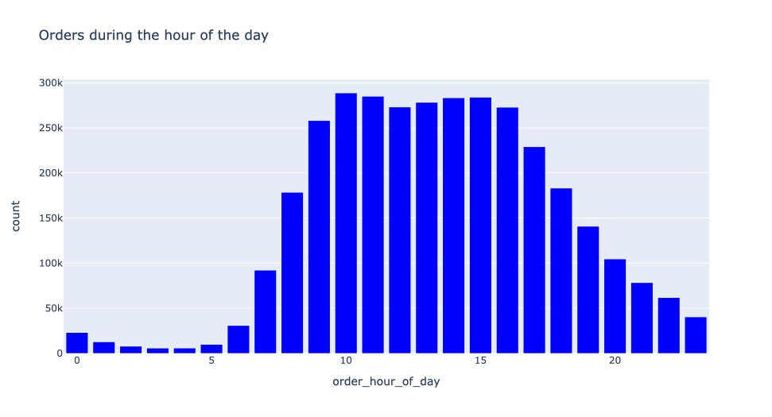
Objective 1 - EDA

Slide 5
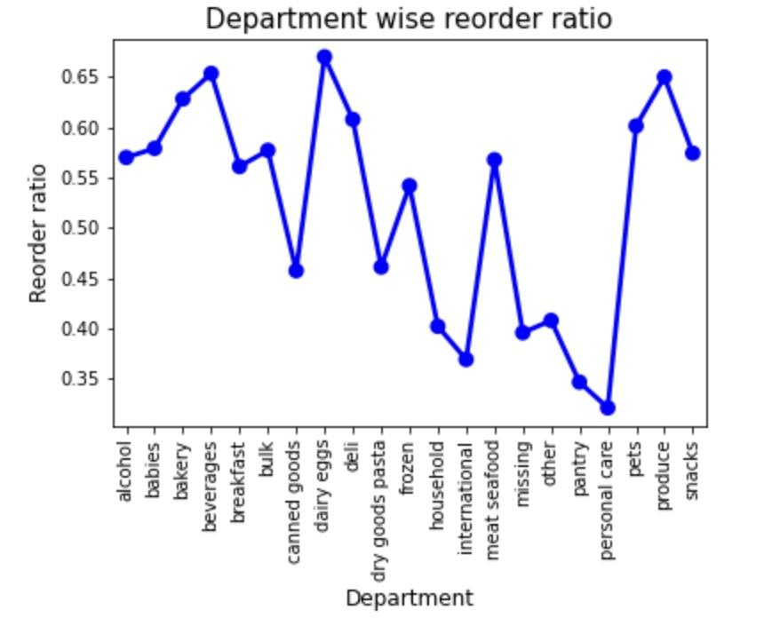
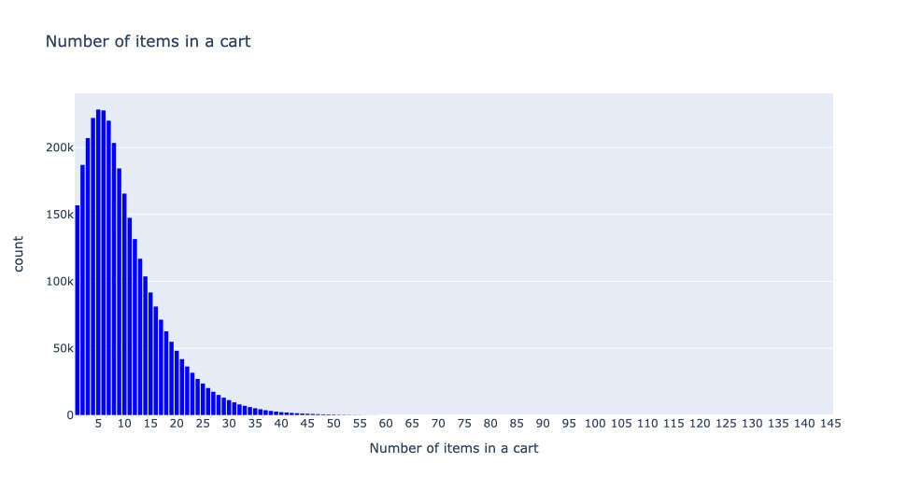

Slide 6
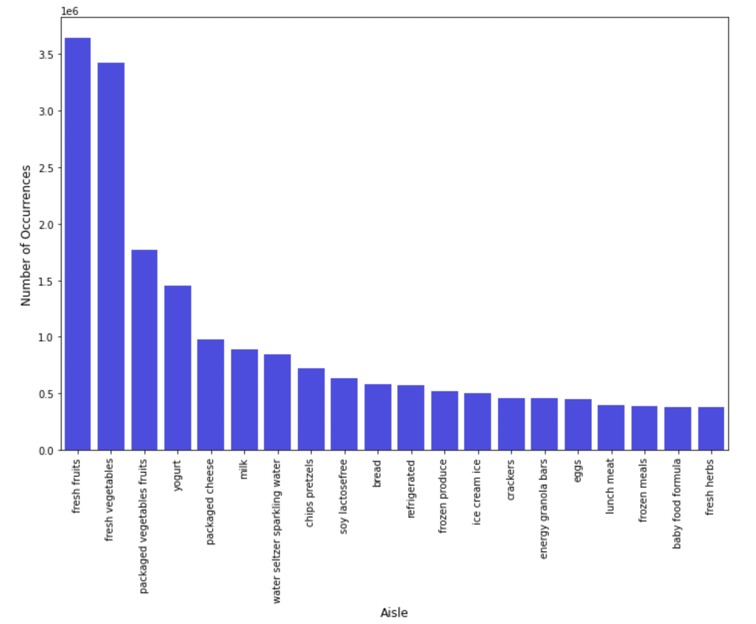
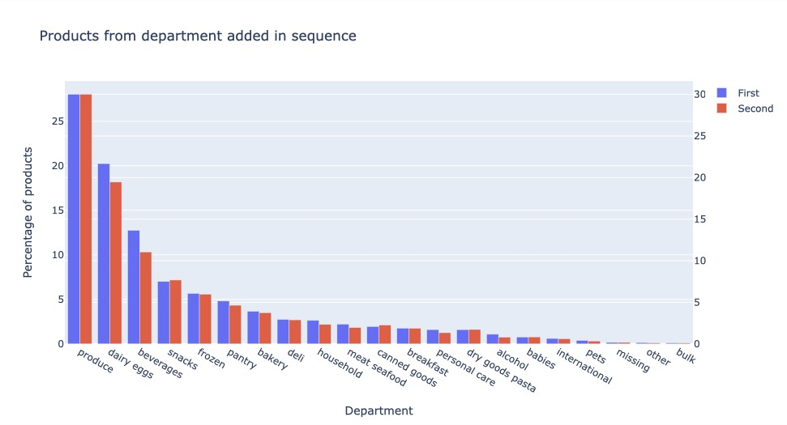

Slide 7
Objective 2 - Association Rule Mining
Association rule mining technique when used in Market Basket Analysis enables one to find sets of items that are often found together in a customer’s basket.
This can be used to improve or create bundles of products to improve sales.
Also, the created bundles can be used to provide special offers for customers with discounted pricing on bundled products.
We have used fpgrowth algorithm from mlxtend module to extract frequent itemsets and association_rules module to generate the rules.
Link - http://rasbt.github.io/mlxtend/user_guide/frequent_patterns/fpgrowth/

Slide 8
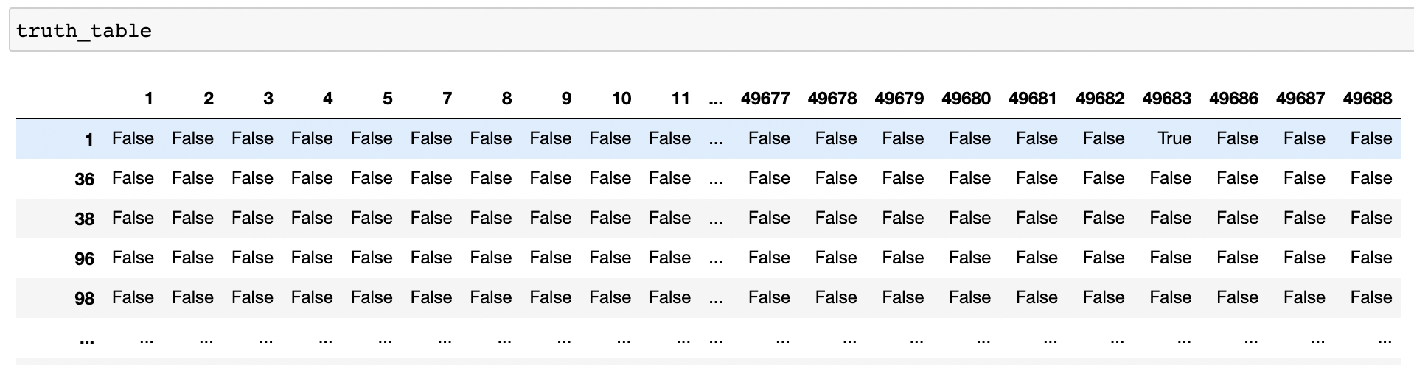
Implementation
The products which belong to the same order_id are grouped together, and this information is used to create a truth table of order_id and products.

Slide 9
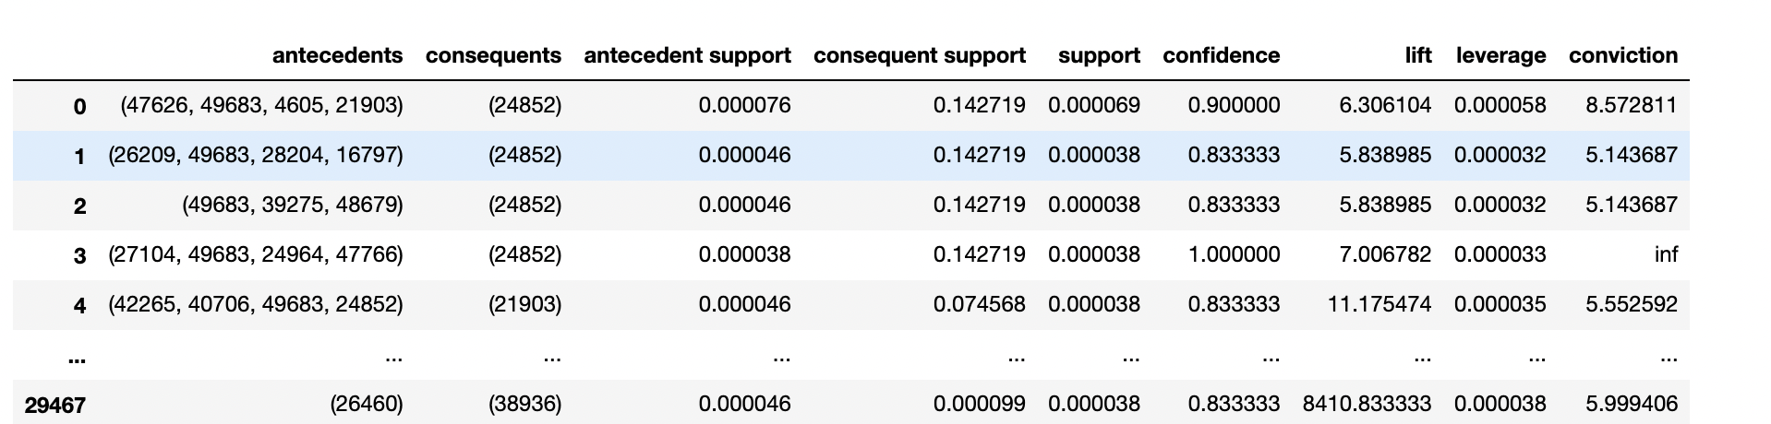
The generated truth table is fed into fpgrowth algorithm to generate frequent itemsets, and the generated frequent itemsets are given as input into association rules with a threshold value to generate the association rules.

Slide 10
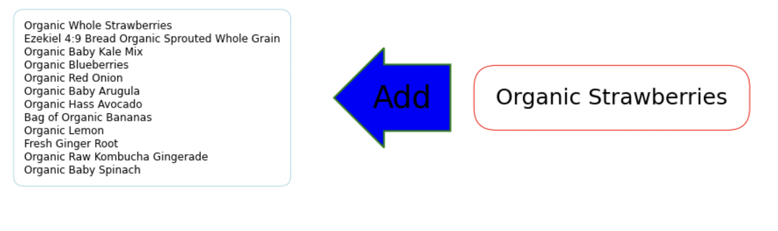
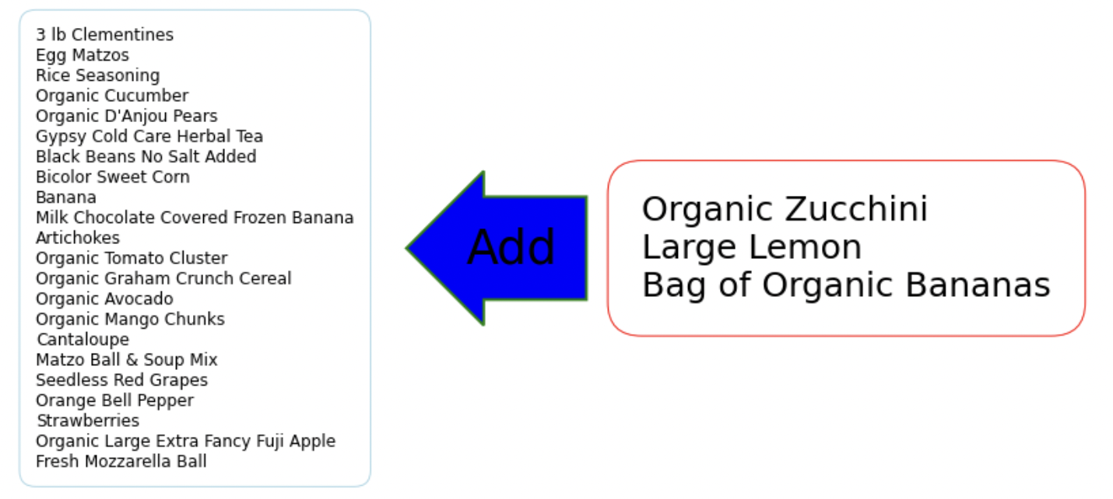

Slide 11
Analysis of the consumer-base for a brand
Important questions:
Which customers should a brand invest into?
How is the consumer-base divided?
How to determine which strategies are applicable to what type of consumer base?
Knowing who your most valuable customers are, what their potential future spending amounts to, and how they engage with your brand is critical.
Addressing customer segments based on their projected lifetime value is a huge opportunity to optimize marketing spendings and build long-lasting relationships with valuable customers.
Solution? RFM Analysis with CLV

Slide 12
RFM Analysis for Customer Segmentation & estimating Consumer Lifetime Value (CLV)
What is RFM (Recency, Frequency, Monetary) Analysis?
RFM value is a marketing analysis tool used to identify a firm's best clients based on the nature of their spending habits.
Three main factors:
Recency: Computed by calculating the days between a customer’s sequential orders.
Frequency: How often a customer makes a purchase?
Monetary Value: How much money a customer spends on purchases?
Scores are assigned based on these factors and aggregated.
Aggregated score used for segmentation.
Can be also done by using K-Means clustering.*

Slide 13
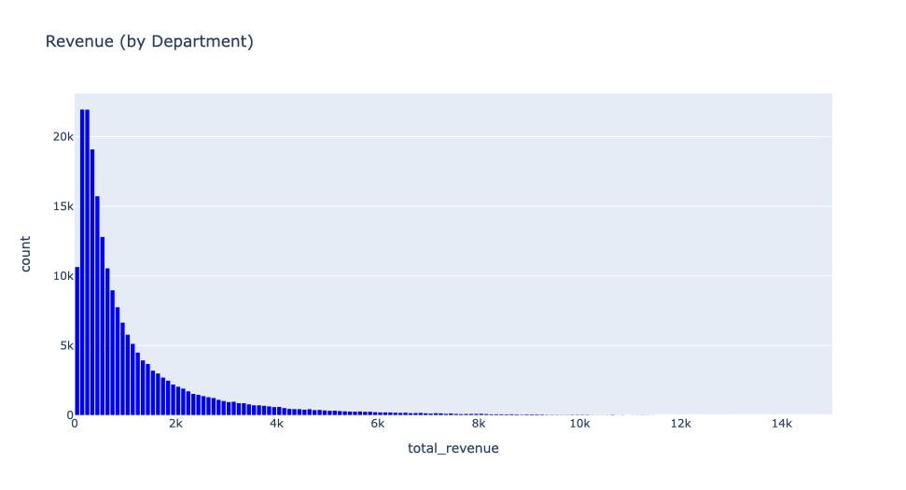
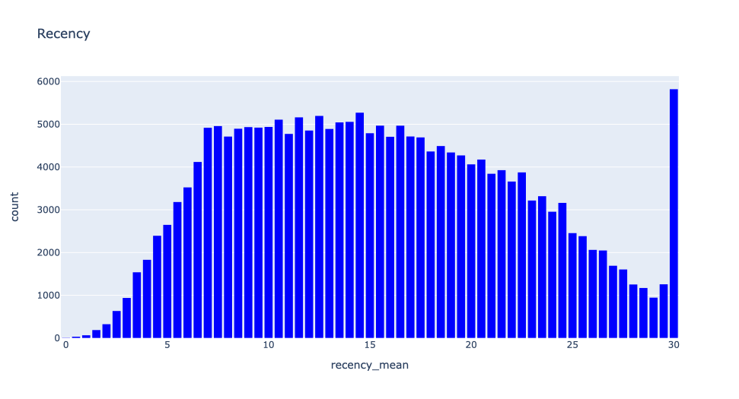
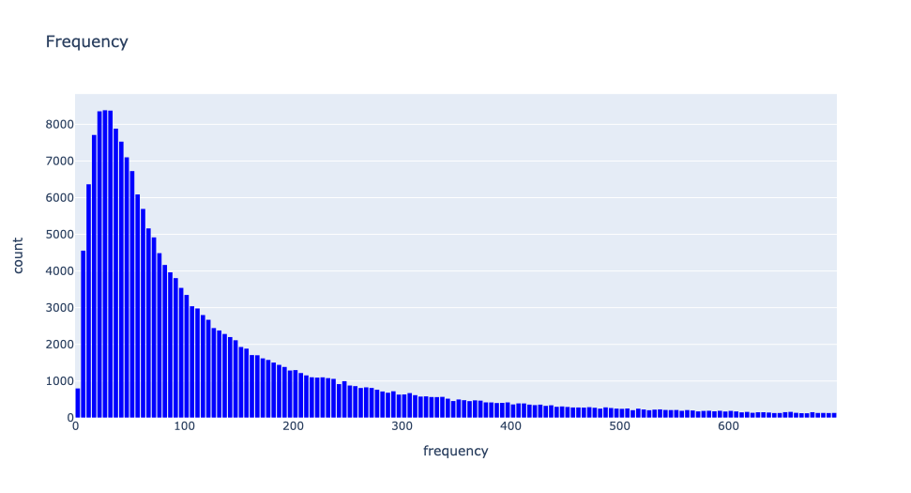
Calculate the RFM score (for each Customer)
quantile-cuts
quantile-cuts
quantile-cuts
[1-5]
[1-5]
[1-5]
RFM(CLV) score = [1-125]
equal-cuts
Segments: {1, 2, 3, 4, 5}

Slide 14
Applications:
Predicting the RFM score using ML algorithms using base metrics.
Performing k-Means clustering on each of the customer “segments” to gain insights.
Use cases: Customer Lifetime Value estimation.

Slide 15
RFM Prediction:
SMOTE used to handle class imbalance.
Models used:
Logistic Regression
Random Forest Classifier
Decision Tree Classifier
XGBoost Classifier
Classifier | Accuracy | F1-score
Logistic Regression | 37.2 % | 0.327
Random Forest Classifier | 94.22% | 0.9421
Decision Tree Classifier | 97.6% | 0.983
XGBoost Classifier | 98.3% | 0.988

Slide 16
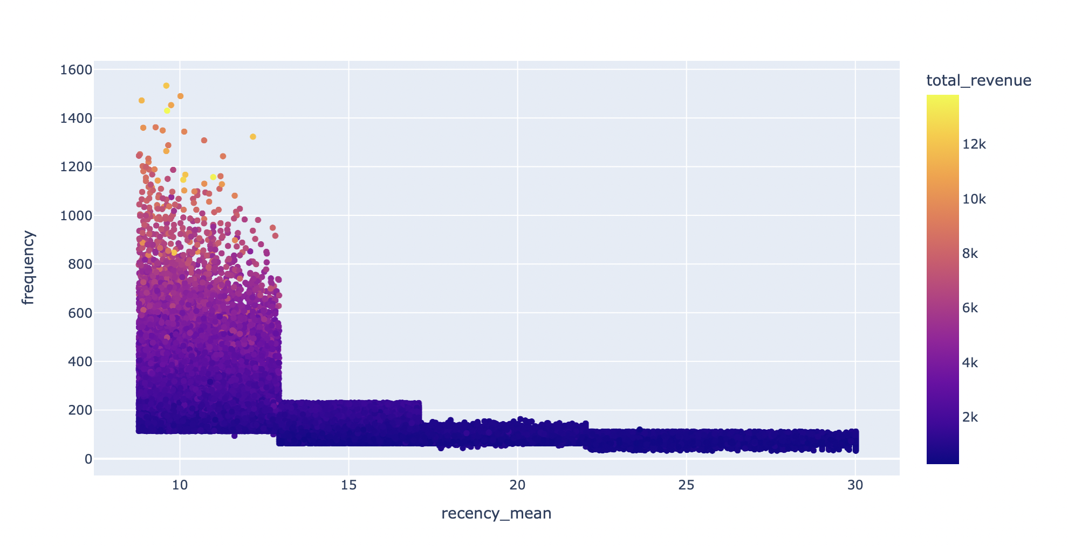
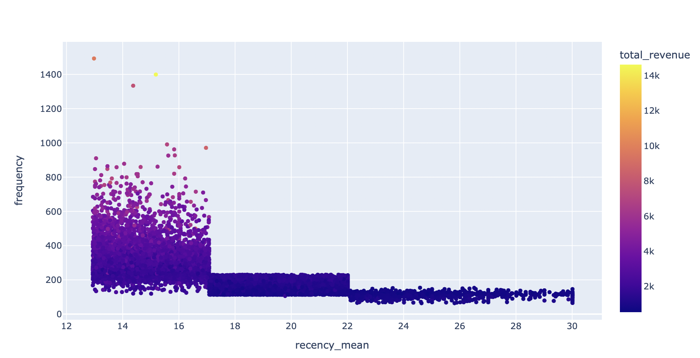
Clustering:
For Customer segment #3:
For Customer segment #2:
K-Means Clustering on all of the Segments to further analyze Customer behavior.

Slide 17
Customer Lifetime Value
Customer lifetime value is the total worth to a business of a customer over the whole period of their relationship.
Needs additional information like Date of the orders, Churn rate to exactly estimate the Lifetime Value.
But we can use our product associations to predict an estimate how much a customer will potentially be valuable to us.

Slide 18
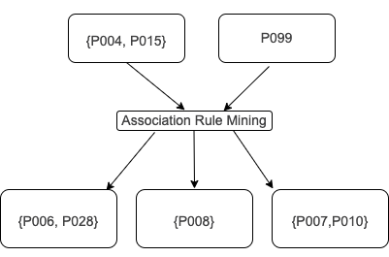
Example:
This additional information can be used to get an estimate of the projected possible revenue a consumer would bring. This can be improvised by subplementing Offers, Promos and Marketing campaigns.
Add to the prior information & predict CLV

Slide 19
Use Cases:
Target specific consumer groups/demographics to expose them to Offers, Loyalty programs, benefits and more based on the clusters in the segments.
CLV helps to estimate profits against the Customer Acquisition Costs.
ML model to predict RFM efficiently based on the raw features.

Slide 20
References:
http://rasbt.github.io/mlxtend/user_guide/frequent_patterns/fpgrowth/
https://www.qualtrics.com/experience-management/customer/customer-lifetime-value/
https://knowledge.dataiku.com/latest/kb/industry-solutions/rfm-customer-lifetime-value/rfm-customer-lifetime-value.html
https://clevertap.com/blog/rfm-analysis/
http://www.brucehardie.com/papers/rfm_clv_2005-02-16.pdf

